Slide 1
CS 608 Algorithms
Week 3 Dr. Tom Schmidt

Slide 2
Week 3 Agenda
Quiz
Recurrence and the Master Method
Strassen’s Algorithm, Redux
The Hackerrank Problem, and my problem
Heapsort
Google Interview; Hamburg and Goethe
Homework
Wrap-up and review

Slide 3
Week 3 Objectives
After your readings and this lecture, you will be able to:
Work problems related to applying the Master Method
Understand Heapsort
Know Asymptotic Notation cold

Slide 4
Quiz
1) Prove that n^3 = 8^lgn
2) Answer two of these four
A) Describe the process of showing the running time of an algorithm by induction
B) Describe the process of showing the running time of an algorithm by recursion tree
C) Describe the process of using the Master Method to show the running time of an algorithm
D) Build a heap by inserting the following values: 22, 37, 31, 41, 33, 17, 8, 5, 22, 38. Show all additions and re-heaps.

Slide 5
Last week

Slide 6
Last week

Slide 7
Quiz, Week 2 questions?
1) Ask away!

Slide 8
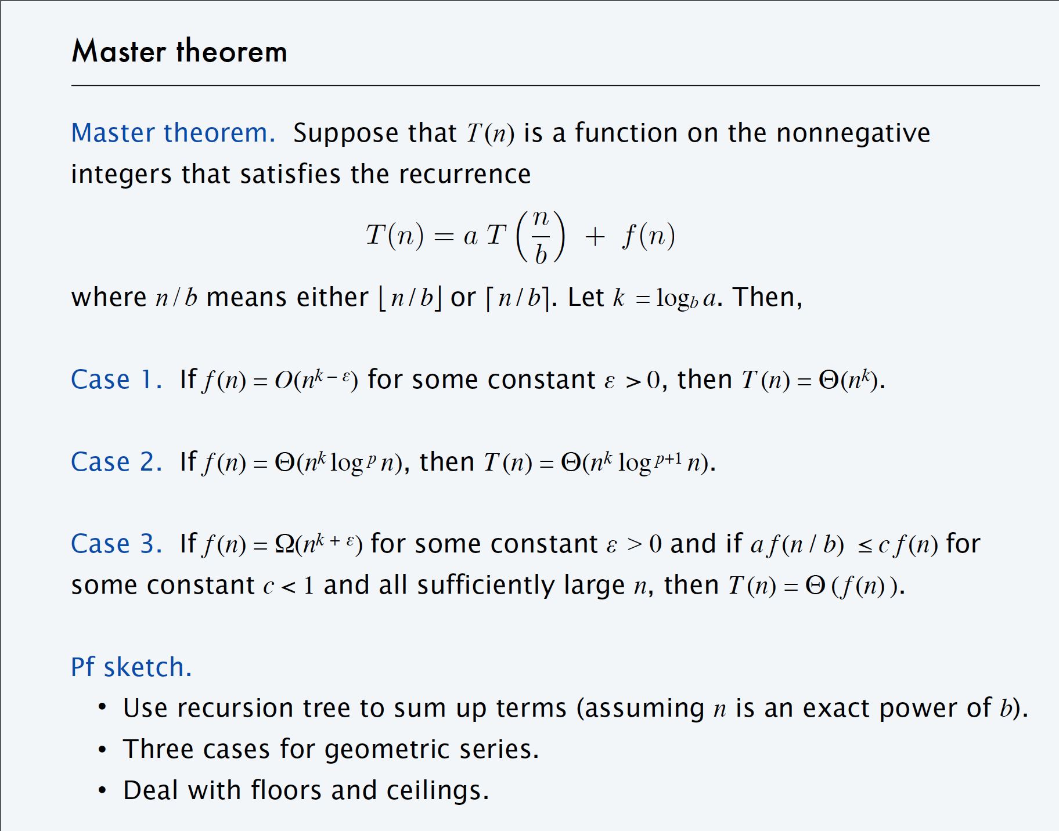

Slide 9
Recurrence and the Master Method
From This Deck, once More?

Slide 10

Notes:
Suppose you have a Recurrence of form T(n) = 8T(n/2) +n^2. How could you solve it?
https://www.polleverywhere.com/multiple_choice_polls/blriZgFiAuAvXSX

Slide 11
Strassen’s Algorithm
From this Deck

Slide 12
Notes:
Strassen's algorithm computes a matrix multiply in time n2.81. How important is this over the normal matrix multiply?
https://www.polleverywhere.com/multiple_choice_polls/RX8lSJ7ywD5AKPD

Slide 13
n | logn | n | nlogn | n² | n³ | N^{2.81}
4 | 2 | 4 | 8 | 16 | 64 | 49
8 | 3 | 8 | 24 | 64 | 512 | 345
16 | 4 | 16 | 64 | 256 | 4,096 | 2419
32 | 5 | 32 | 160 | 1,024 | 32,768 | 16962
64 | 6 | 64 | 384 | 4,094 | 262,144 | 118950
128 | 7 | 128 | 896 | 16,384 | 2,097,152 | 834180
256 | 8 | 256 | 2,048 | 65,536 | 16,777,216 | 5,849,979
512 | 9 | 512 | 4,608 | 262,144 | 134,217,728 | 41,025,000
1024 | 10 | 1,024 | 10,240 | 1,048,576 | 1,073,741,824 | 287,701,998
The Growth Rate of the Six Popular functions

Slide 14
The HackerRank Problem
In which we hear from Reuben

Slide 15
The HackerRank Problem
In which we hear from Sir Robert, and perhaps Jana

Slide 16
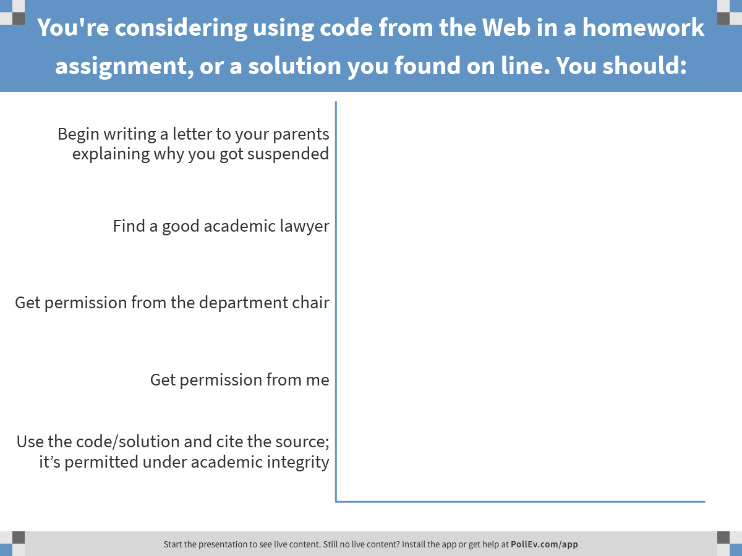
Notes:
You're considering using code from the Web in a homework assignment, or a solution you found on line. You should:
https://www.polleverywhere.com/multiple_choice_polls/aSVlECHrMaEPt3J

Slide 17
Heapsort
Review this deck

Slide 18
Notes:
Heapsort is?
https://www.polleverywhere.com/multiple_choice_polls/9hXXVX5grMpE6s5

Slide 19
Google Interview
A member of Teams Hamburg and Goethe

Slide 20
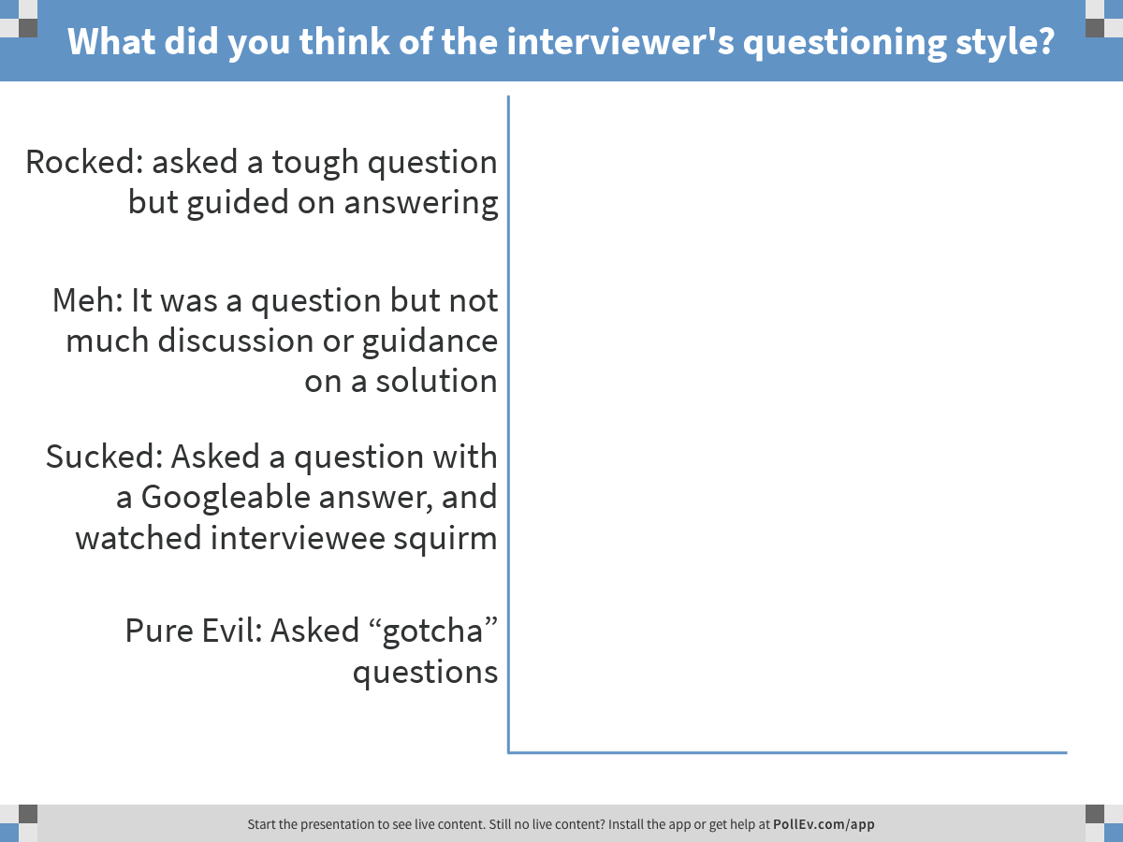
Notes:
What did you think of the interviewer's questioning style?
https://www.polleverywhere.com/multiple_choice_polls/gXPkEw1cpnly2ho

Slide 21
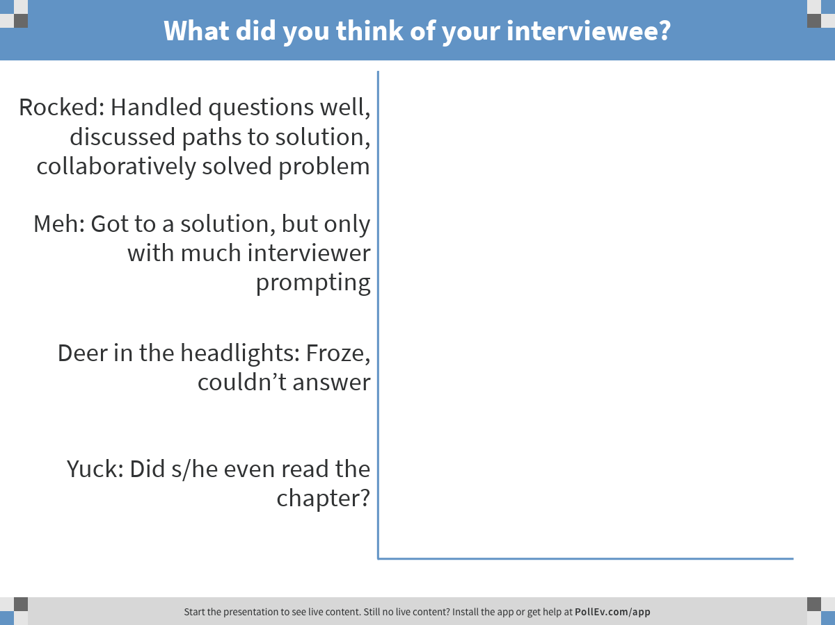
Notes:
What did you think of your interviewee?
https://www.polleverywhere.com/multiple_choice_polls/2Bcwzs8oRbfzQ4C

Slide 22
Homework
Exercise 3.1-4
4.1 a through e page 107
4.3 f through j page 108
Exercise 6.4-1 Page 160

Slide 23
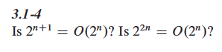
Exercise 3.1-4, practice

Slide 24
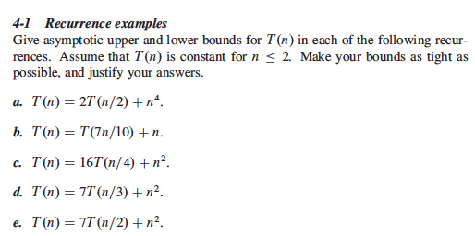
4.1 a through e Team BMW

Slide 25
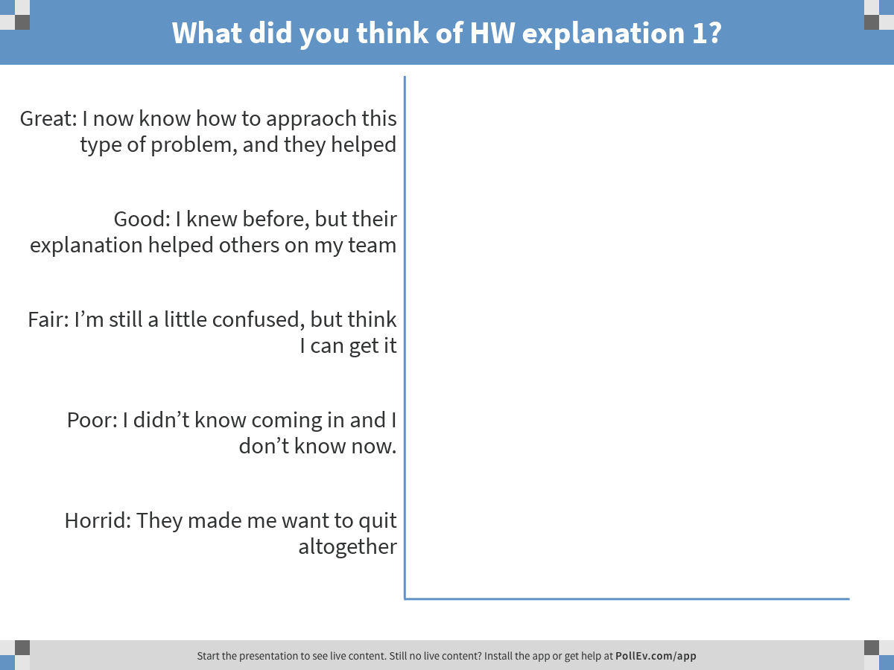
Notes:
What did you think of HW explanation 1?
https://www.polleverywhere.com/multiple_choice_polls/8vmrgZ3VhcBHQvH

Slide 26
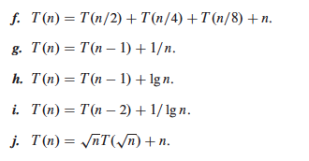
4.3 f through j Team Brandenburg

Slide 27
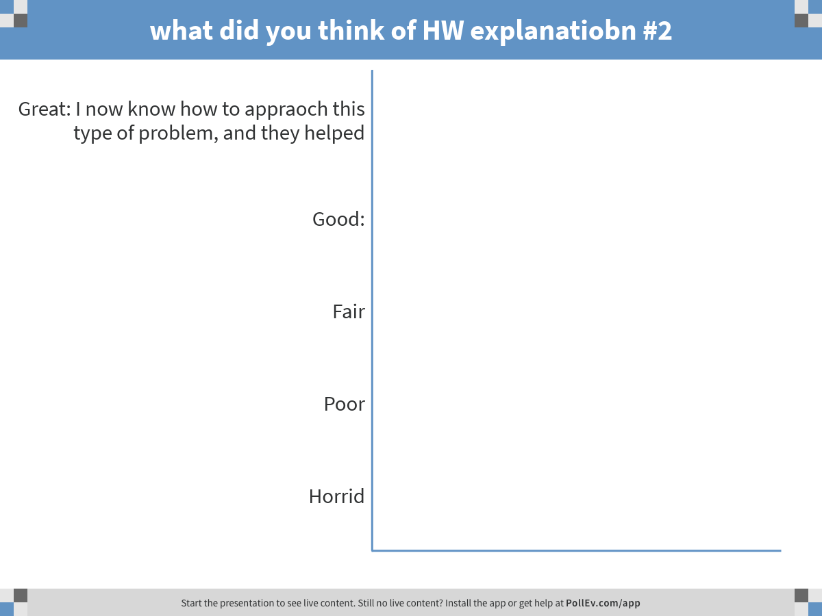
Notes:
what did you think of HW explanatiobn #2
https://www.polleverywhere.com/multiple_choice_polls/BL1zpHfb2mm0Ruz

Slide 28
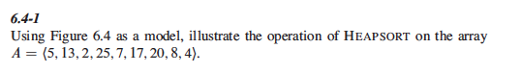
Exercise 6.4-1, Heapsort

Slide 29
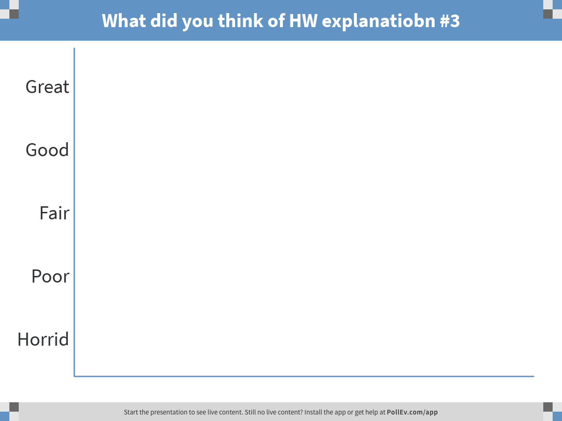
Notes:
What did you think of HW explanatiobn #3
https://www.polleverywhere.com/multiple_choice_polls/Yafw9lfl8l8gPr8

Slide 30
Wrap-up and review
About how much time did you spend on the homework?
Did you consider any question fun or interesting, and if so, which one(s)
Thank you and శుభ రాత్రి (Śubha rātri)

